Slide 1



Dig That Lick & Jazzomat Digital Jazz Research
Klaus Frieler
Institut für Musikwissenschaft, Weimar-Jena
„From No Time to Ragtime“
JLU Gießen
May 6, 2019

Slide 2
Agenda
Part I: Presentation
Computational Musicology: What, why, how?
Jazzomat Research Project, Dig That Lick, Weimar Jazz Database
Assorted Examples
Ideational Flow Model
Midlevel analysis (MLA)
Patterns
Conclusion & Outlook
Part II: Question & Answers
Part III: Hands-on for everyone
Part IV: General discussion

Slide 3
Computational Musicology

Slide 4
Computational Musicology
Complements and enhances existing and provides new analysis methods.
Pioneered by corpus-based sub-fields of musicology (e.g., ethnomusicology, old music research).
Boos since the early 2000s boost driven by Music Information Retrieval and by pervasion of computers and the internet („Music Google“).
Very active research field.
Connections to many different subfields of musicology
Computational ≠ digital musicology!

Slide 5
Computational Musicology
Advantages:
Facilitates collection and curation of big data sets (improved reliability).
Necessary to analyse big musical data sets.
Acceleration of research processes.
Development, test and simulation of models.
Enables analysis pathways that are otherwise hard to obtain (e.g., timbre, intensity, intonation).

Slide 6
Computational Musicology
Issues:
Focus on quantitative methods.
Often a simplified but detailed and specific definition of concepts is needed to suit them for computer-use (can also be an advantage!).
High entry threshold (extra knowledge in maths, computer science, stats, machine learning, signal procession etc. required).
„Proving the obvious“ (but: „hindsight bias“).
Fear of “trivializing” the music and the musician.

Slide 7
Computational Musicology
Transcriptions
Audio
Metadata
Score
Sound Analysis
Music Analysis
Statistics
Results

Slide 8
Jazzomat Research Project, Dig That Lick & the Weimar Jazz Database

Slide 9
The Jazzomat Research Project
DFG funded research project at the University of Music “Franz Liszt” Weimar, from 10/2012-4/2017 (Prof Martin Pfleiderer)
Compiling the Weimar Jazz Database with 456 high-quality monophonic jazz solo transcriptions.
Developing analysis tools (MeloSpySuite, MeloSpyGUI):
Feature extraction, visualization
Pattern search and pattern mining.
Data import/-export
Research focus:
Jazz research, jazz history, stylometrics.
Psychology musical creative processes.
Music informatics, statistical music analysis, MIR.
Jazz pedagogy, jazz theory, didactics of improvisation.

Slide 10

Follow-up project of the Jazzomat Research Project
Funded as part of „Diggin into Data“-Initiative. From 10/2017-09/2019
International project partners from London, Paris, New York, Urbana Champaign, IL, Weimar
Dedicated to all things patterns and licks in jazz solos ( types, style, transmission, history, creators).
Goal: Assembling a big solo database (~ 1,000 - 10,000 solos) using automated transcriptions and extensive discographic metadata (Lord).
Development of tools for pattern mining and search.

Slide 11
Studies so far and forthcoming
Style classification post-bop vs. bebop/hard bop
Solo dramaturgy
Microtiming & swing
Sound analysis (loudness/accents, vibrato, intonation etc.)
Case studies (e.g., So What, Bob Berg‘s solo on Angles, style comparison Trane ./. Miles)
Feature history of jazz improvisation
“Weimar Bebop Alphabet”
Ideational flow model/mid-level analysis
Perception of virtuosity, musicality, and emotions in jazz
Walking bass
Patterns in jazz (WJD, Charlie Parker)
Automatic solo generation
Anatomy of a Lick
https://jazzomat.hfm-weimar.de/publications.html

Slide 12
Transcriptions
Performance-oriented approach.
Annotated sequences of tone events described by onset, pitch, duration.
Annotations:
Metadata (manual),
Harmonic context (manual),
Metrical context (semi-automatic),
phrases/MLUs (manual),
F0 modulations (manual),
Intensities (automatic).

Slide 13
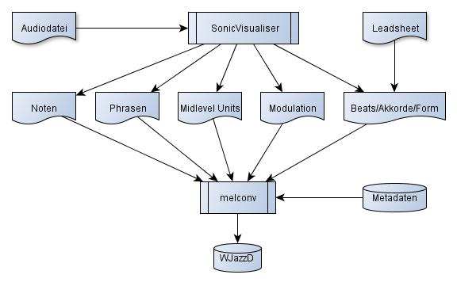
Transcriptions: Practice

Slide 14
Klanggestaltung/Sound
Wichtige expressive Mittel:
Frequenzmodulationen,
Intensität/Lautheit,
Intonation.
Manuelle Annotation von Modulationen durch die Transkripteure (Vibrato, Bend, Fall-off, Slide).
Lautheit ist nicht manuell zu annotieren.
Dito: Intonation.
Lösung: Automatisierung.

Slide 15
Acoustical Annotations
Sound and timbre hard to describe and to measure with traditional methods.
Transcriptions informed automatic main melody extraction.
f₀ tracking, intonation and intensity measurement on extracted solo.
f₀ curves: vibrato frequency, vibrato amplitude, f₀ gradient etc.

Slide 16
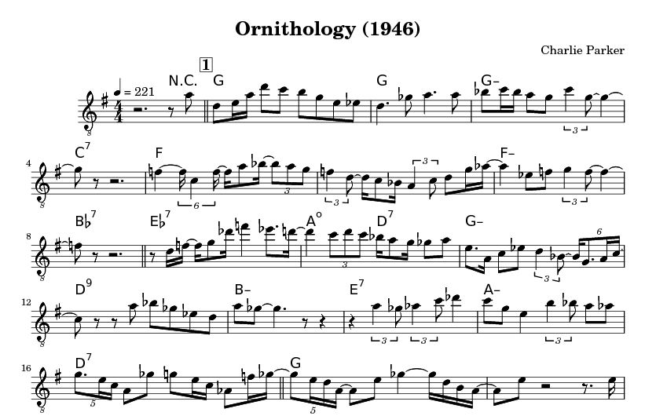



Jazz Karaoke with Charlie
Charlie Parker
Ornithology 1946

Slide 17
Weimar Jazz Database (WJD)
456 solos by 78 different performers.
200,809 tone events.
Top performer: Coltrane (20), Davis (19), Parker (17), Rollins (13), Liebman (11), Brecker (10), Shorter (10), S. Coleman (10).
Styles: traditional (32), swing (66), bebop (56), cool (54), hard bop (76), post-bop (147), free (5 = Ornette Coleman).
Instruments: ts (158), tp (101), as (80), tb (26), ss (23), other (68).
Time range: 1925 – 2009
Focus on the jazz canon, nearly exclusively US-American musicians.
Exercise: Which 500 solos would you choose to represent of all jazz?

Slide 18
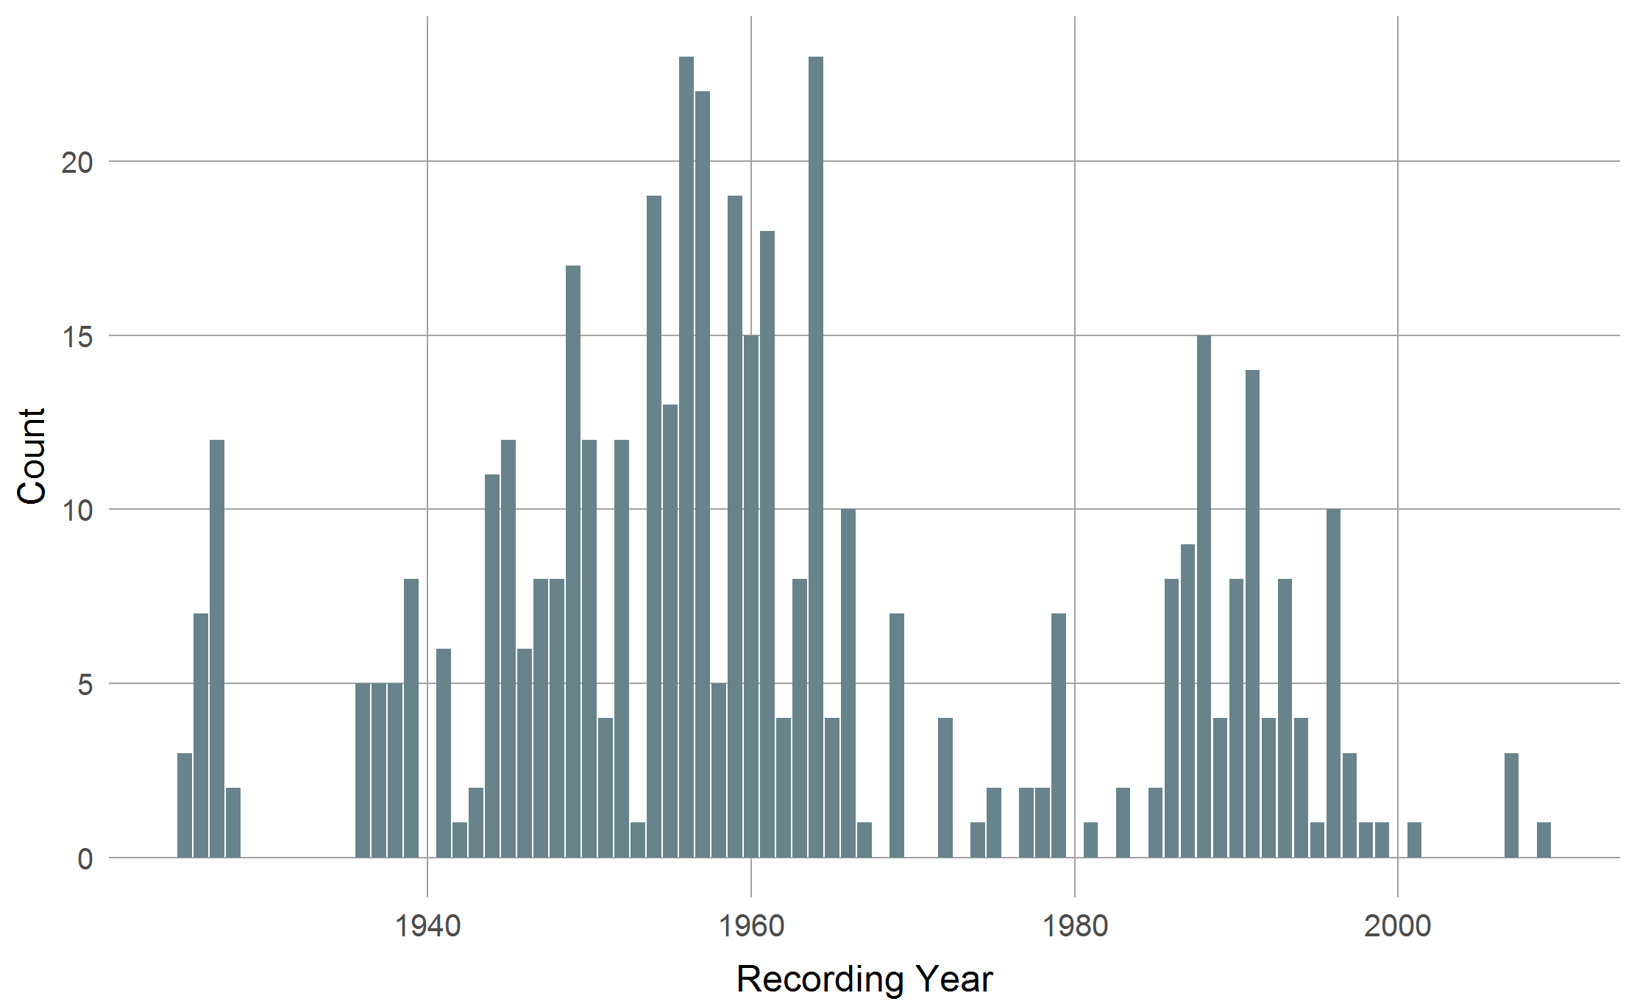
Distribution by Time
Golden Era
Bigband Gap
Fusion Gap

Slide 19
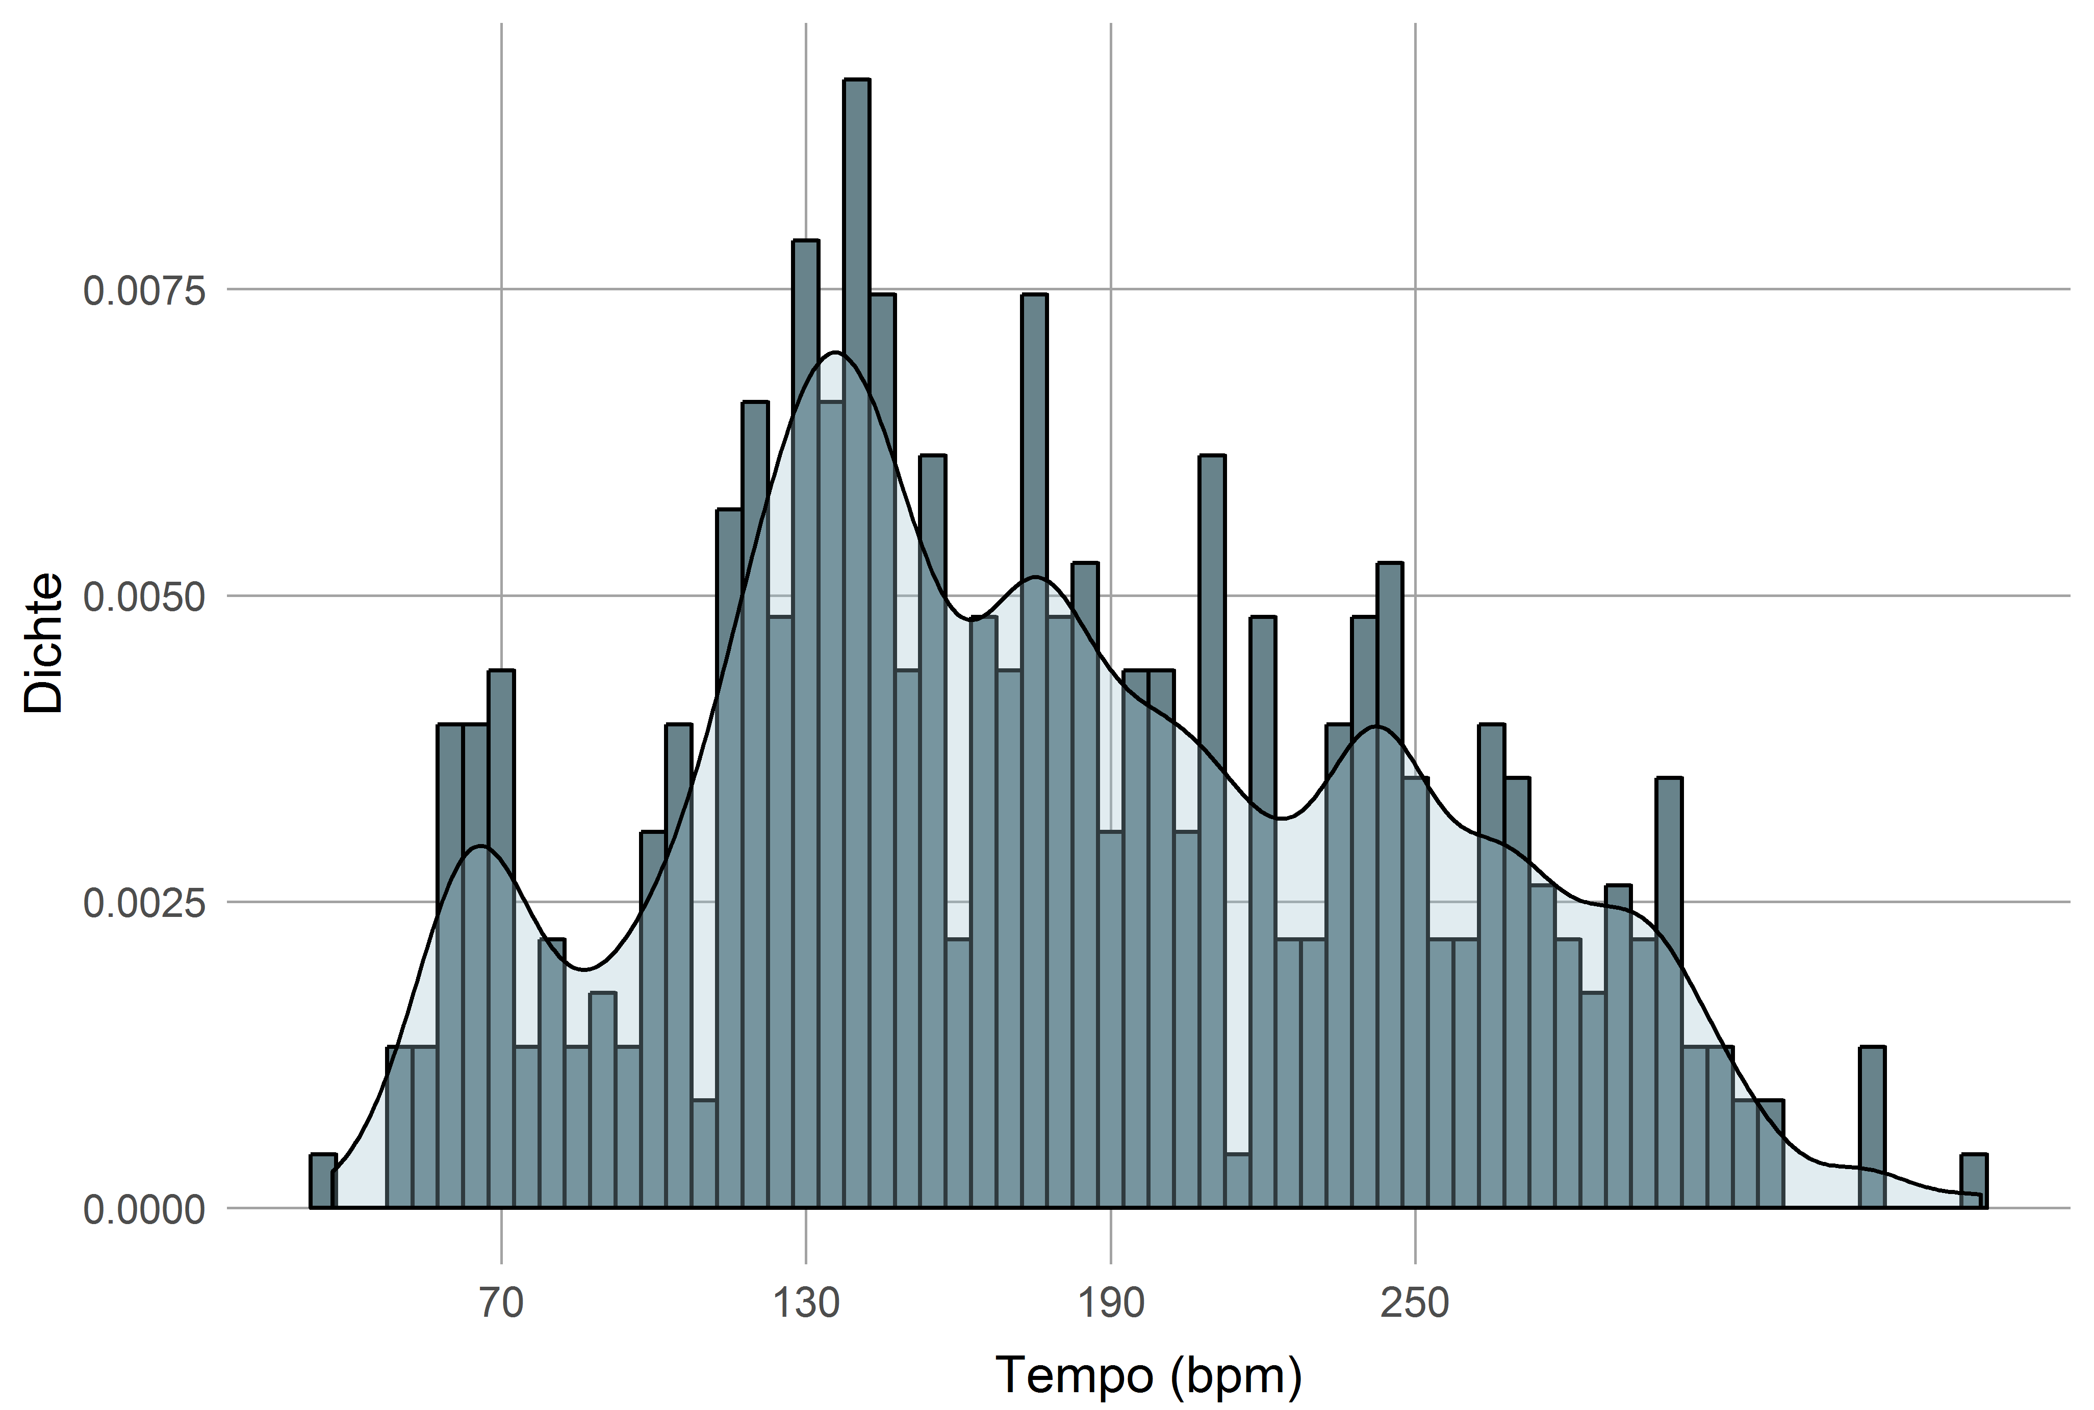
Tempo Distribution

Slide 20
Assorted Examples

Slide 21
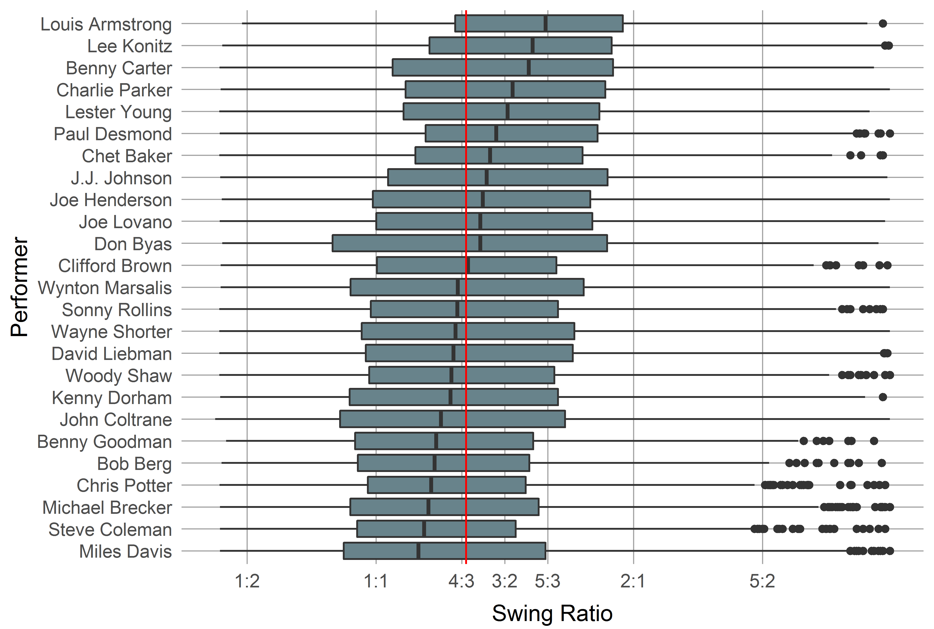
Example: Swing Ratio
Average swing ratio (long:short) is 4:3.

Slide 22
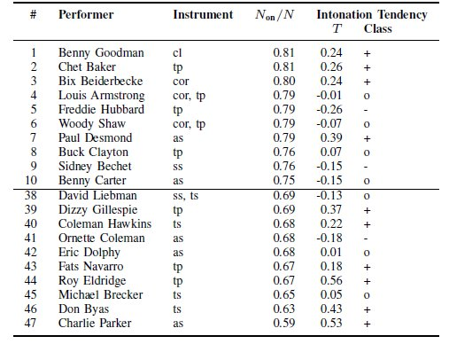
Example: Intonation
Average: N_{on}/N = .72

Slide 23
Excursion: Features
Features are numerical or categorial properties here of melodies.
Mostly based on some transformation of the melodical surface.
External metadata also considered features.
Possibility space for feature is virtually infinite (modular construction system: „feature machine“).
Currently, over 600 pre-defined features in the MeloSpyGUI.

Slide 24
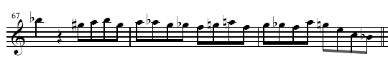

Excursion: Transformations
Excerpt from Bob Berg’s solo on „Angles“
pc: 10 8 9 10 8 9 8 7 6 5 6 9 5 7 6 5 9 7 4 0 10
cpc : 7 5 6 7 5 6 5 4 3 2 4 6 2 4 3 2 6 4 1 9 7
cdpc: 5 4 T 5 4 T 4 3 B 2 3 T 2 3 B 2 T 3 2 6 5
int: -2 1 1 -2 1 -1 -1 -1 -1 2 2 -4 2 -1 -1 4 -2 -3 -4-2

Slide 25
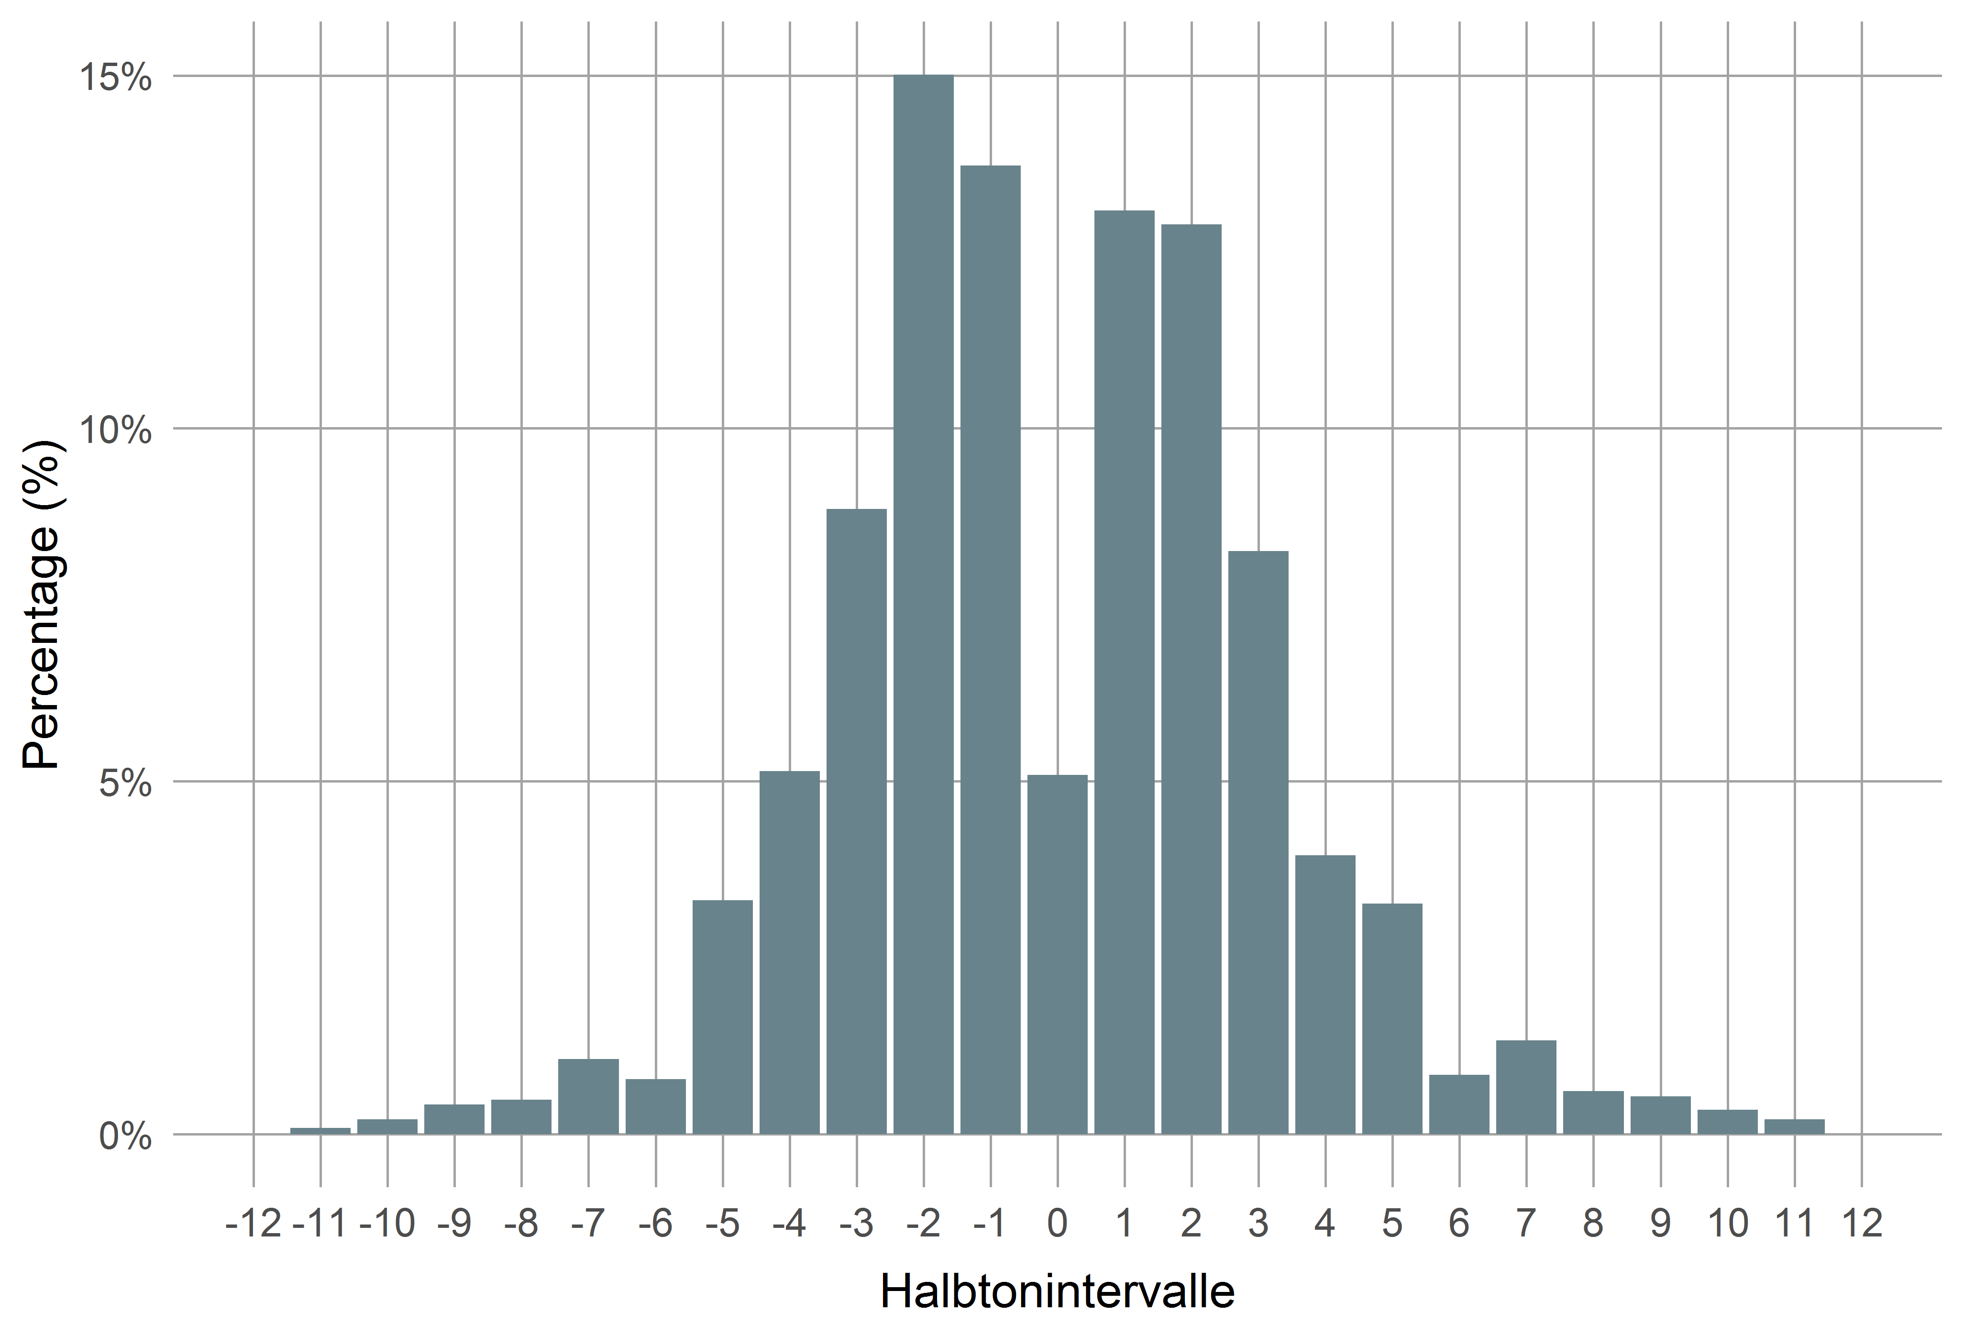
Example: Interval Distribution

Slide 26
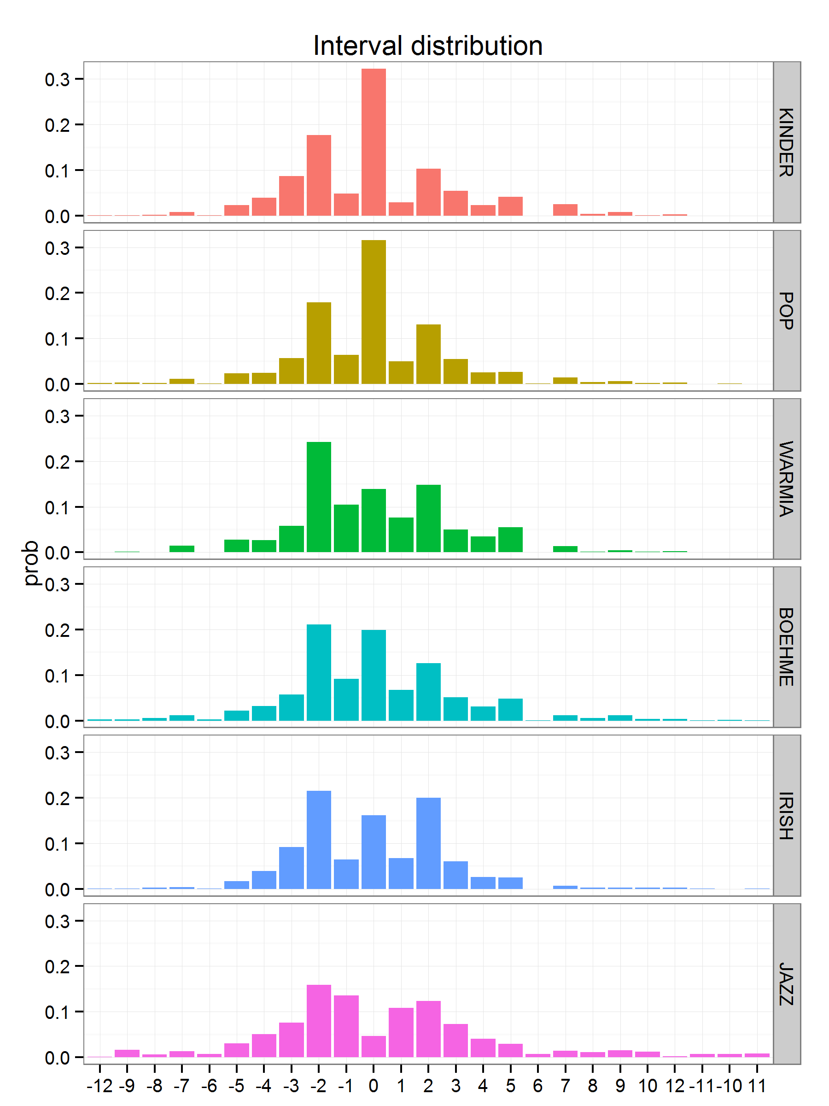
intervallverteilung

Slide 27
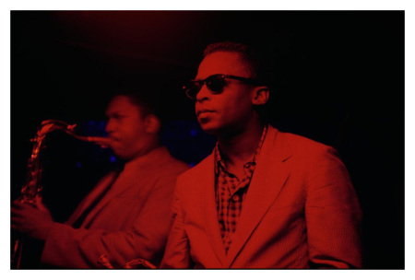
Example: Miles vs. Trane
 | John Coltrane | Miles Davis
Rhythm | Mostly fast lines („Sheets of sound“) | Rhythmically more diverse
 |  | Longer tones & pauses
Intervals | More descending | More ascending
 | Less tone repetitions | More tone repetitions
 | Larger intervals | Smaller intervals
 | More thirds & arpeggios | Fewer thirds
Pitch | Larger pitch range | Smaller pitch range
 |  | Avoids thirds, more blue notes
Midlevel Units | More lines, expressive & fragments | More licks, melody & void
Patterns | More patterns | Fewer patterns
 | No common pattern vocabulary

Slide 28
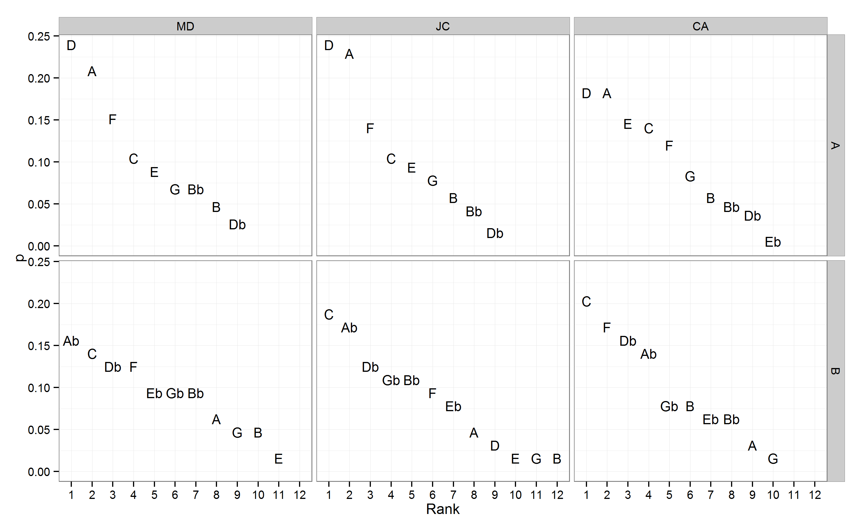
Example: So What (pc, bass)
D dorian
Eb dorian?

Slide 29
Ideational Flow Model

Slide 30
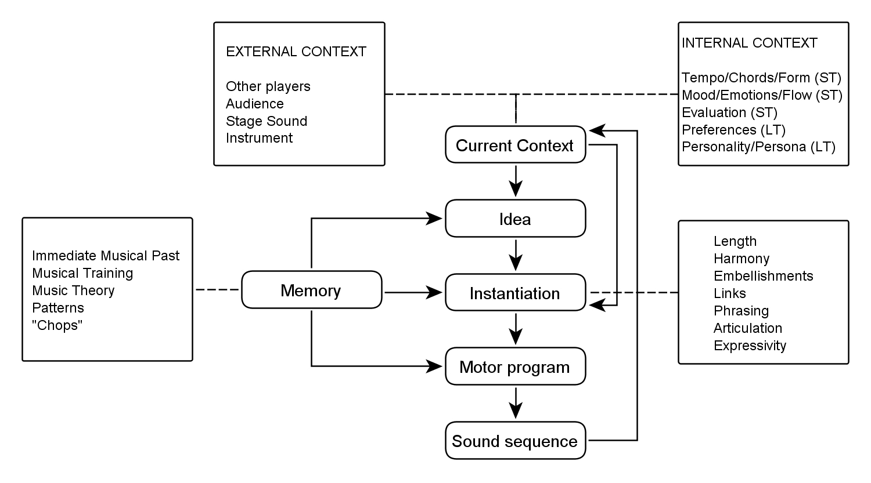
Ideenflussmodell

Slide 31
Midlevel Analysis
Aim: To phenomenologically describe the underlying „ideas“ of improvisers on a middle time level ( ~ few seconds).
Qualitative method, inspired by content analysis and Grounded Theory.
Category system for midlevel units (MLU) extracted from the data (open and axial coding).
Manual annotation by transcribers.

Slide 32
Midlevel Analysis
Continuous and gap-less annotation of the musical event stream with midlevel units (MLUs, „ideas“).
No overlap between MLUS.
Hierarchical category system:
9 main types (line, lick, rhythm, expressive, theme, quote, fragment, void)
18 subtypes,
39 sub-subtypes.
Annotation of motivic relationships between MLUs.

Slide 33
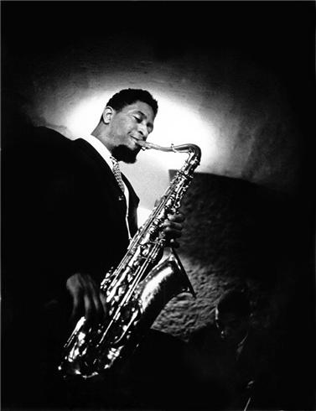
MLA: Example Sonny Rollins: Blue Seven

Slide 34
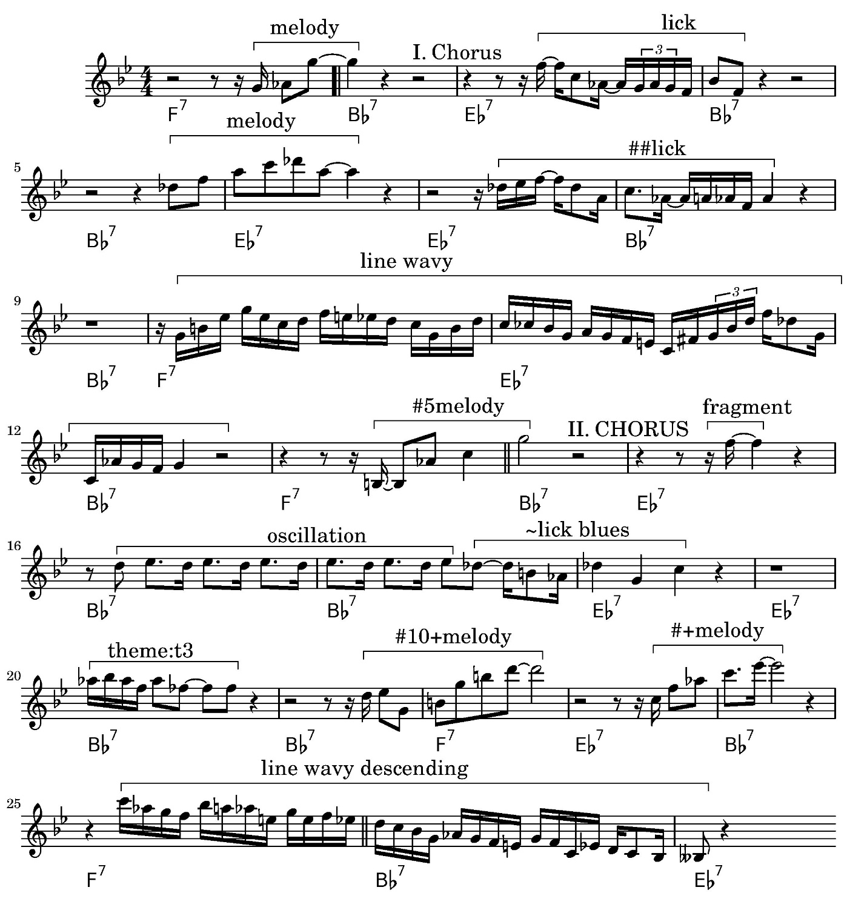


Slide 35
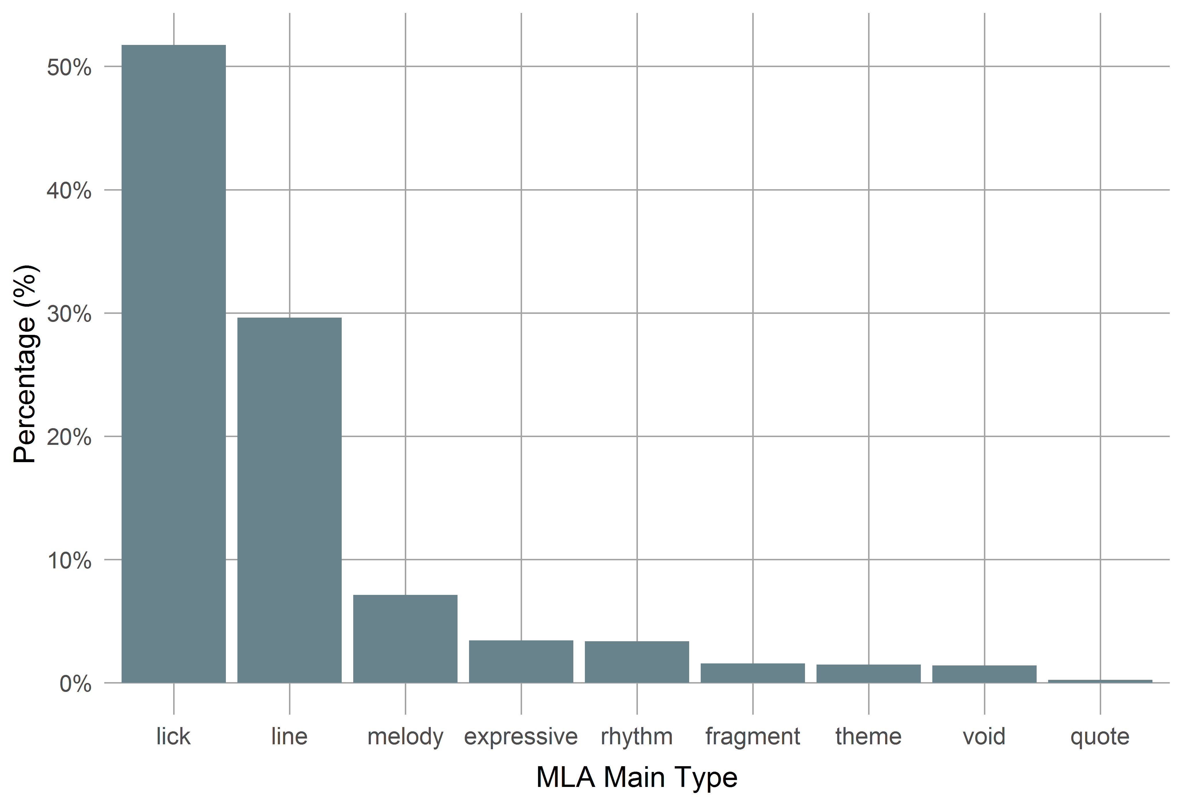
MLU: Distribution
Percentage of derived MLUs:
M = 25.1%
Average duation: 2.3 s / 2.2 measures

Slide 36
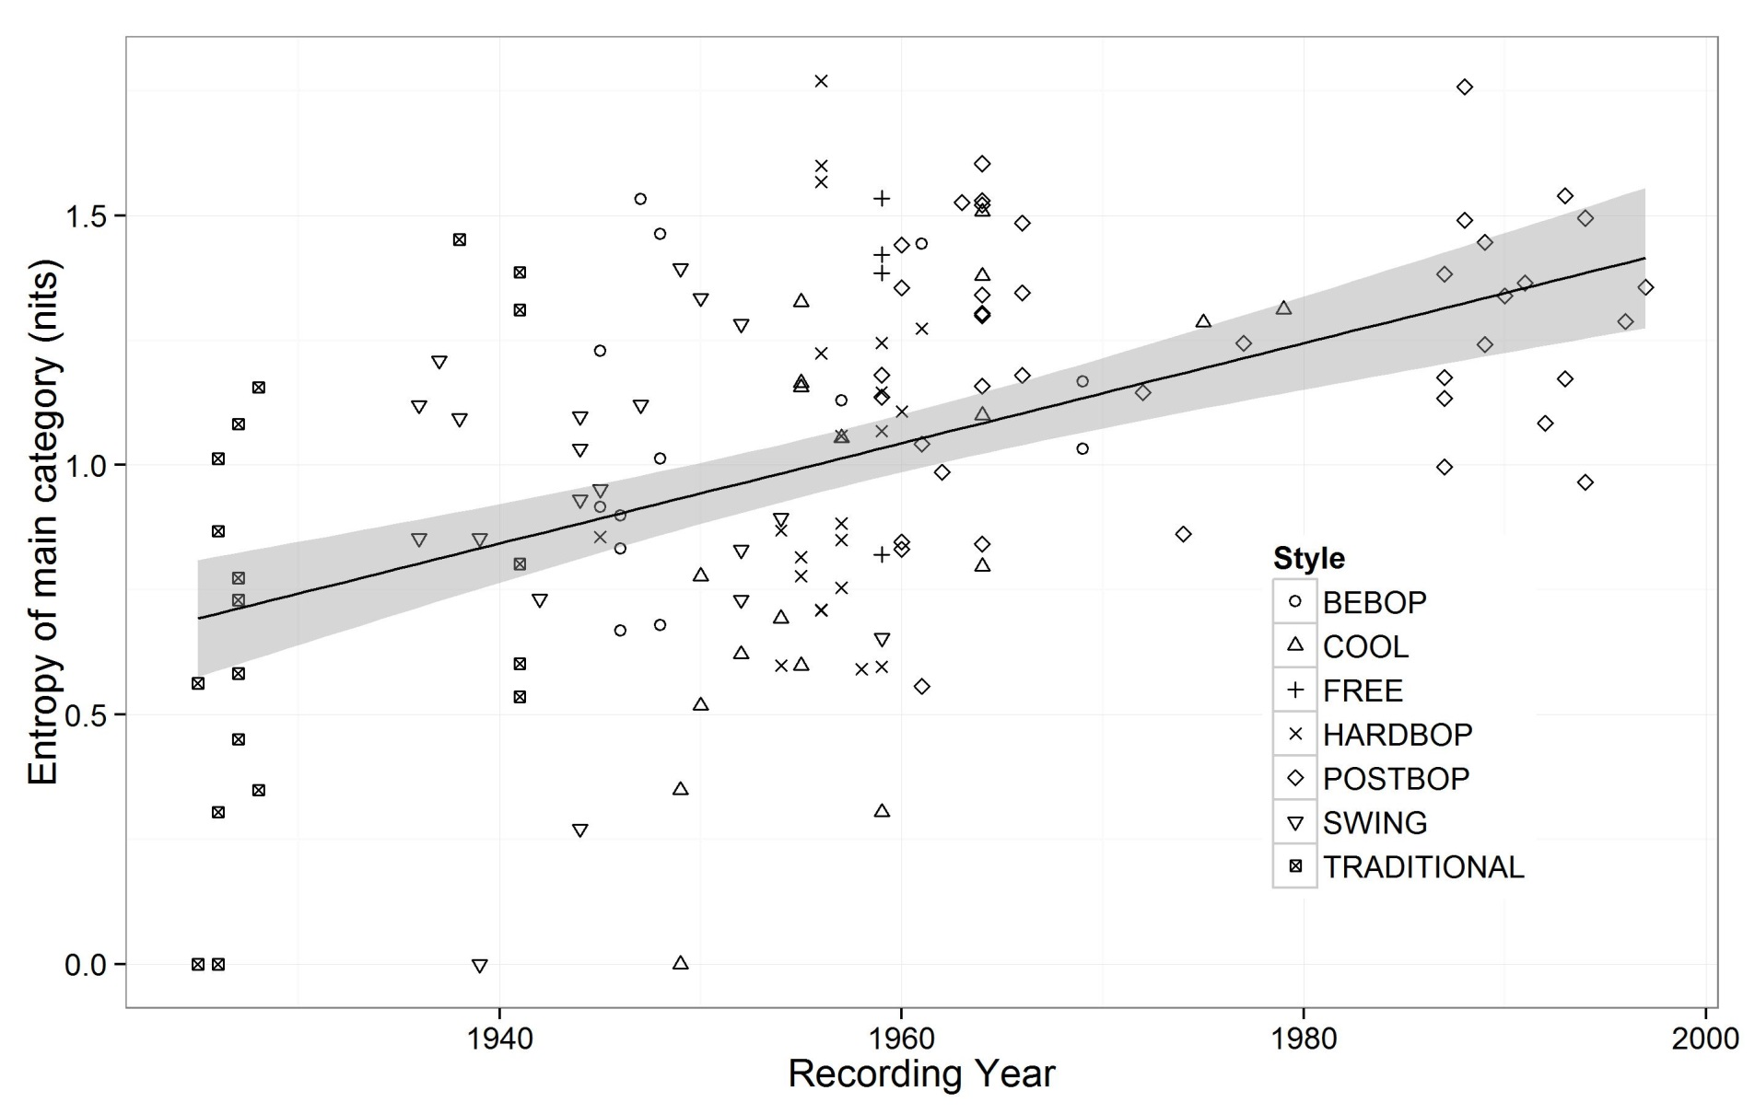
MLA: MLU Multitude

Slide 37
Patterns in Jazz
Using licks and formulas (patterns) important for jazz improvisation.
How can patterns as basic buildings blocks be shown?
How much of a solo is based on patterns?
Can (oral) transmission of patterns be retraced?
Investigation of exact, realised patterns.
Patterns are short snippets (N-Grams) in a set of sequences, with certain conditions (frequencies).
Basic sequences are transformations of tone events (mostly intervals and pitches)

Slide 38
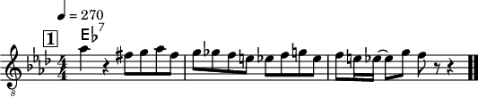

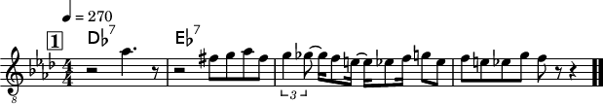
Patterns: Example
18-tone int pattern by Bob Berg on „Angles“.
[-2, 1, 1, -2, 1, -1, -1, -1, -1, 2, 2, -4, 2, -1, -1, 4, -2]
17-tone int pattern by Charlie Parker on „Scrapple from the Apple“ und „Billies Bounce“.
[-1, -2, -2, -2, -1, -2, -2, -1, 3, 3, 3, 2, -3, -2, 2, -3]

Slide 39
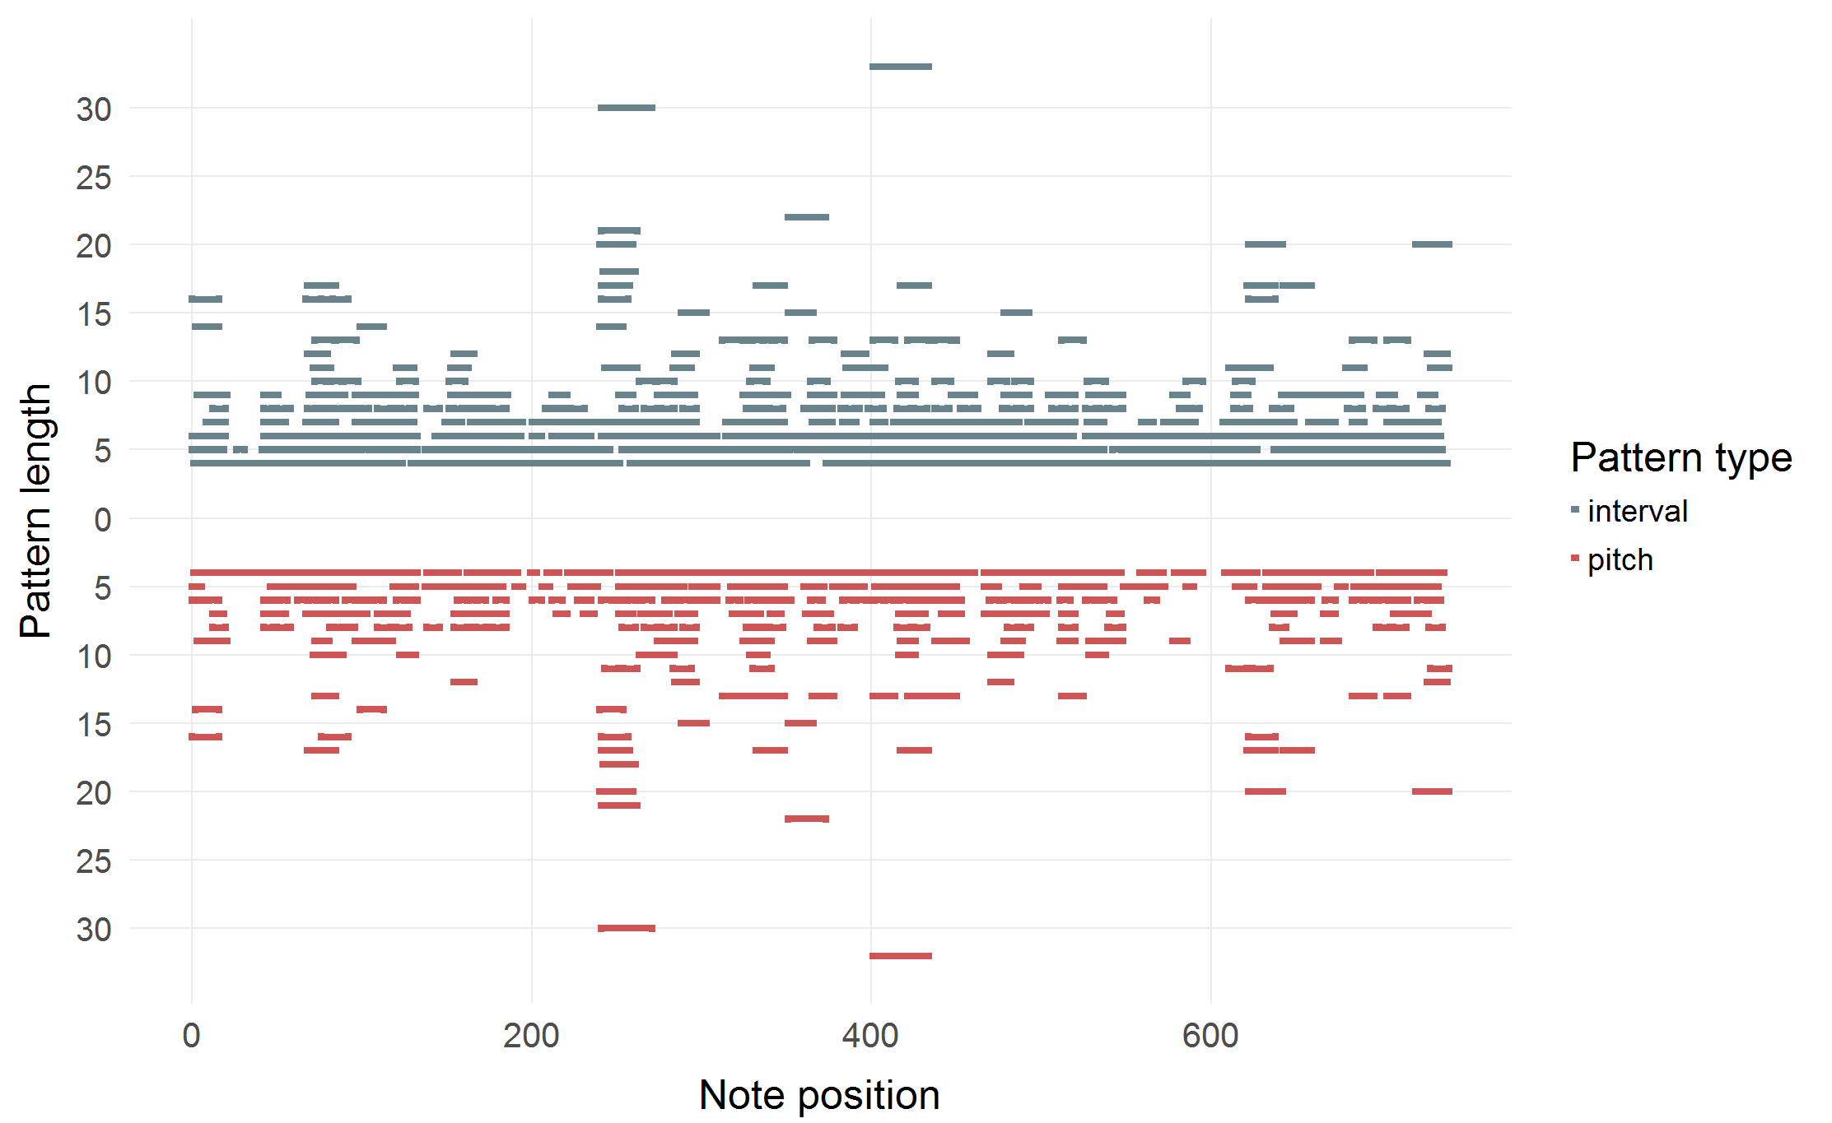
Example: Pattern partition (Charlie Parker, Koko)

Slide 40
Ideational Flow Model

Slide 41
Conclusion & Outlook

Slide 42
Conclusion
Computational, statistical and corpus-based methods offer interesting new possibilities for jazz research.
Quantitative approaches complement and enhance traditional, qualitative methods.
Computer-based analysis enables new investigations that are hard or impossible to accomplish without (e.g., intonation, patterns).

Slide 43
Outlook
Possibilities of computational musicology far from exhausted yet.
Analysing multitrack recordings (e.g., Montreux archive).
Polyphonic soli (piano)
Rhythm section/accompaniment.
Interaction.
Analysis-by-synthesis: Test of improvisation models by automatic generation of jazz soli.

Slide 44
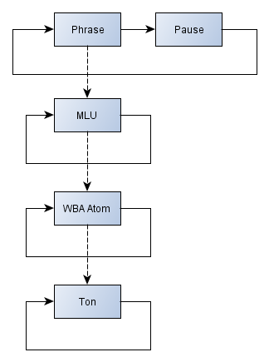
Outlook: A Grammar for Jazz Solos
WBA atoms:
Repetition
Diatonics
Chromatics
Arpeggios
Approaches
Trills
X-atoms

Slide 45

Outlook: Automated Solo Generation
Musical Turing Test:
Which solo is computer generated?

Slide 46
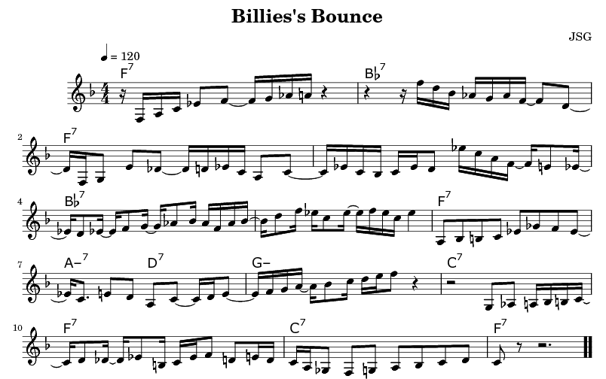
Outlook: Automated Solo Generation

Slide 47
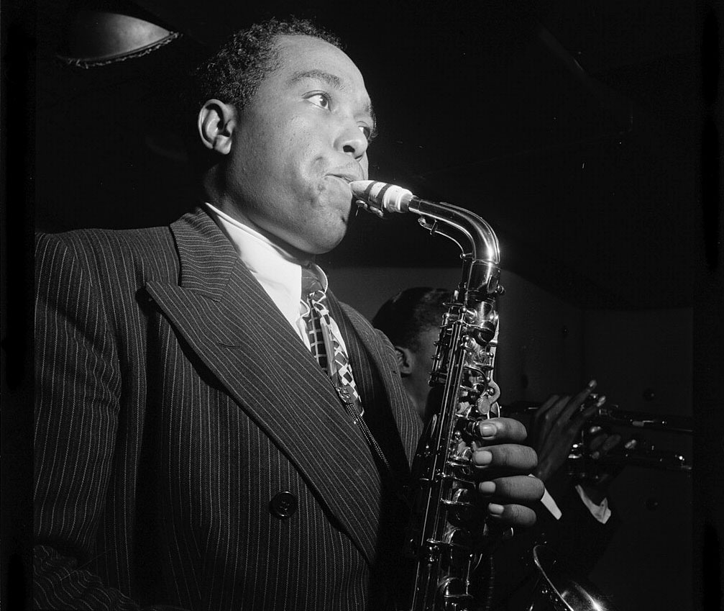
Thank
you!
Questions?
http://jazzomat.hfm-weimar.de/

Slide 48
Part III Hands-on for everyone

Slide 49
JRP/DTL Web Tools
Tools to be used
Feature History Explorer
Pattern History Explorer
Dig That Lick Pattern Search
Dig That Lick Similarity Search
Links: https://jazzomat.hfm-weimar.de/interactive.html

Slide 50
Feature History Explorer
Visualizes development of solo features in the WJD over time.
x-axis: recording year (or decade).
y-axis: selected feature.
Scatterplot with (polynomial) regression line.
Goodness-of-fit values: R², p value, AIC.
With or without aggregation.
Filtering, colouring, and presentations options.
Selecting area in plot displays data table for selected solos (only for unaggregated data).

Slide 51
Pattern History Explorer
Contains selection of 653 common interval patterns by eminent performers and its instances in the WJD.
See “Help” tab for further details
Listen & See: Shows pattern instances (score, audio, metadata)
Instances: More detailed info on instances
Stats: Stats for the pattern and its instances
Timeline: Distribution of instances over recording time and performers
General Stats: Stats of all patterns

Slide 52
Dig That Lick Pattern Search
Allows very flexible search for patterns in the WJD, the Essen Folk Song Collection and the Omnibook.
Entry via abstract notation or virtual keyboard.
Many different types of patterns. (“transformations”)
Secondary search (search in search results).
Metadata filter
Displays scores and audios + additional metadata.

Slide 53
Dig That Lick Similarity Search
Allows similarity search for patterns in the WJD,.
Entry via abstract notation or virtual keyboard.
Interval, fuzzy interval, pitch and CDPCX patterns.
Metadata filter.
Filter for extra conditions.
Displays audios + additional metadata.
Timeline and network visualizations.

Slide 54
Exercises
All questions and exercises (+ more) can be found here:
https://github.com/klausfrieler/digthatlick_lecture
Exercise are of different difficulty levels and mostly open ended.
Please choose freely exercises and tools you want to work on.
Group work highly recommended.
Ask me anything anytime.
Send me your results, if you want to have feedback.
You might want to start with the green ones.
Have fun!

Slide 55
Feature History Explorer
Questions & Tasks (select as you wish)
What das abs_int_range mean? Give an intuitive explanation.
What drives the trend in abs_int_range?
What does CDPCX mean?
Which CDPCX values show significant trends?
How do trends changes when you select “Mean” aggregation? Why?
Find a feature with a much better quadratic trend ( = larger R² and smaller AIC).
Which solo has the highest event density, which the lowest?
Which feature has the strongest aggregated trend?

Slide 56
Pattern History Explorer
Questions & Tasks (select as you wish)
Find the longest arpeggio patterns. Who owns it?
Find the longest “non-trivial” (non-trill, non-repetition) pattern. What can be said of its start pitch, harmonic context, accent pattern?
Find the most frequent pattern with the longest stretch of an ascending or descending whole tone scale. Who owns it? Who played it first (in the WJD)? Which are more common: ascending or descending?

Slide 57
Dig That Lick Pattern Search
Questions & Tasks (select as you wish)
Find “The Lick” in the WJD. Does it exist in the Essen Collection and the Omnibook? (Find the Lick on the internet).
Find the beginning of “Hänschen Klein” in the WJD. Which is the most similar instance, why? Why are other instances not similar at all?
Repeat one of the previous searches Lick with tone context of 2 or more tones before and after. How does it change the pattern impression? What are the most common pre/successions?
Find the longest ascending whole tone scale segment (within a single phrase) with only one search request.

Slide 58
Dig That Lick Similarity Search
Questions & Tasks (select as you wish)
How would you define pattern similarity? How did we define it?
Search for an interval pattern of choice with 5 elements. How many instances for similarity thresholds 1, .75, .5 and maximal length difference 0, 1, 2 do you get?
Search for “The Lick” with min sim = .8, max diff = 0. Then repeat: Start new similarity search (right click on the pattern) for the most frequent and most similar but not identical pattern. Does “The Lick” disappear from the result set? What happens? Why?
Find the most frequent 8-interval pattern by Chris Potter and play it at half speed. Who owns the pattern? How might it reflect influences? What is the most common start pitch? How does is mostly fit the chords? (Tip: Don’t forget the PHE).

